Slide 1
TO MAKE A MOVIE
By Alejandro harrison

Slide 2

Business Overview
So Microsoft, you’ve decided to enter into the Film business, and try your luck at making movies.
The good news is that the Film industry can be a very lucrative business venture considering that the right approach is taken.
In this presentation, we’re going to look at data from the movie industry over the past few years and focus on 3 key factors that can help determine if a movie will be successful in the Box Office:
Genre of movie
Production budget of film
Building on nostalgia or sequels
We’ll then take these factors and see how they can apply to your movie studio’s goal of making profitable Box Office hits.
First let’s take a look at some statistics on the film industry.

Slide 3
The Film Industry
As of 2019, the film industry was worth 42.2 billion dollars globally.
The top 3 movie industries in the world are Hollywood, Cinema of China, and Bollywood, which together make up more than half of the total global revenue.
1.24 billion movie theater tickets were sold in the US and Canada alone.
More than 700 movies are released each year in the United States, but India seems to be the largest producer with 1,500-2,000 movies released each year.

Slide 4
A Successful Movie
So what makes a movie successful?
There are a variety of different factors, ranging from actor’s performance to storyline, to box office reviews, etc.
Some of these factors can result in trends that can be seen when examining movie box office data.
Using box office data that spans over a decade, I have identified 3 factors that influence a movie’s performance in the box office.

Slide 5
Movie Genre
The first factor is movie genre.
Movie genre can be an extremely important factor in whether people go to see a movie or not.
Everybody has their own unique tastes and may favor certain genres over others, but statistically certain movie genres are more popular than others.
However this differs based on the country or location.
Because your movie studio is just starting out, it would be a good idea to focus on reaching the domestic audience for your first movie, then focus later on global audience.
Therefore we’ll only look at popular movie genres in the US (for now).

Slide 6
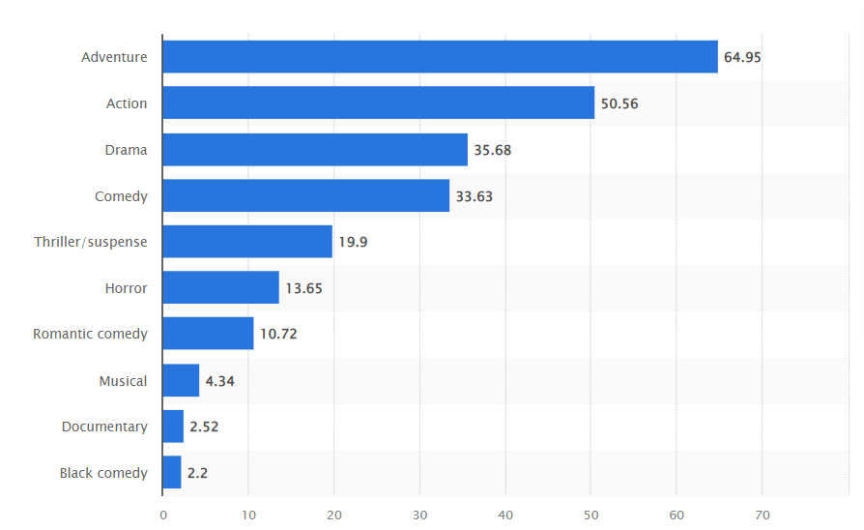
Popularity of Movie Genres In the US
By far the most popular movie genres in the US are Adventure, followed closely by Action.
The figure below represents the most popular movie genres in the US (and Canada) between 1995 and 2022, measured by total box office revenue.
As we can see the Adventure genre has grossed almost 65 billion dollars over the past 27 years, with Action coming in at a close 50.5 billion.

Slide 7
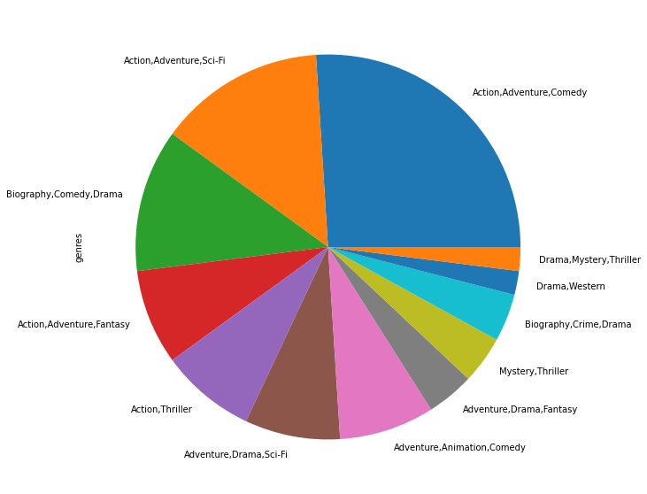
Popularity of Movie Genres In the US
This trend is further supported by data grabbed from IMDB.
The IMDB dataset contained over 85,000 movies along with their ratings, number of people who voted on the rating, the movie director, etc.
When looking at the top 50 most voted movies, more than half of the movies are classified as either action, adventure or both, as shown by the chart.
This trend continued for top 100, 200, etc.

Slide 8
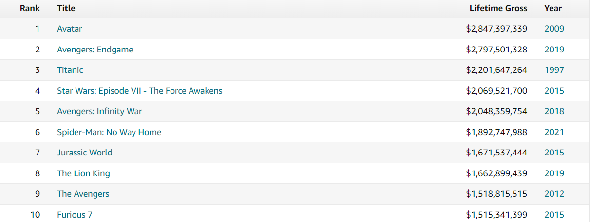
Top Lifetime Grossing movies and Genre
We can look even further at all time top grossing movies to see this trend.
Let’s look at the top 10 lifetime grossing movies.
All of these movies are classified as in the adventure or action genre, with the exception of The Titanic, which is in the drama genre.

Slide 9
Production Budget
The second factor that I’ve identified as an indicator of success is production budget of a movie.
Production costs for making a movie can wildly vary, but on average a movie costs between 100 million and 150 million to make.
But what exactly does production budget include?

Slide 10
Production Budget
Production budget can include:
Paying crew and cast
Post production editing
Filming and equipment costs
Travel
Marketing for the movie

Slide 11


Higher Production Budget Correlation
I wanted to see if there was a relation between production cost and gross box office earnings.
I took a dataset (from The Numbers) full of various movies, that also contained their production budget as well as domestic and global box office earnings.
I ran a Pearson's correlation test on production budget and both box office earnings and found a strong relationship as shown in the figures.
Worldwide box office and production budget had a Pearson’s correlation coefficient of 0.748, while Domestic had a PCC of 0.686.
This suggests that a higher production cost is correlated with higher box office earnings.

Slide 12
Higher Production Budget Correlation
This is most likely due to the fact that a higher production budget allows for things like better special effects, better actors, better marketing, etc.
However it’s important to note that a higher production budget is not always the sole contributor to high box office earnings.
Currently the highest production cost of any movie belongs to Avengers: Endgame, with a production budget of 400 million dollars and a worldwide box office of $2,797,800,564.
Not every movie can have that kind of budget though, and there are several low budget movies whose budget ranged from $60,000 to 11 million, that did well in the box office.
Oftentimes these movies would make more than quadruple their budget in box office earnings.
Surprisingly, many of these are films that we know and love such as Star Wars, The Blair Witch Project, Rocky, Saw, etc.

Slide 13
Sequels and Box Office
This brings me to my last factor: Whether or not a movie is a sequel or builds on a preexisting series.
My theory was that movie sequels and movies that build on preexisting older movie series will do especially well in the box office, because studios play on people’s nostalgia.
While looking through a dataset from Box Office Mojo containing over 3000 movies and their domestic/foreign box office earnings, I noticed a trend that supported my theory.

Slide 14
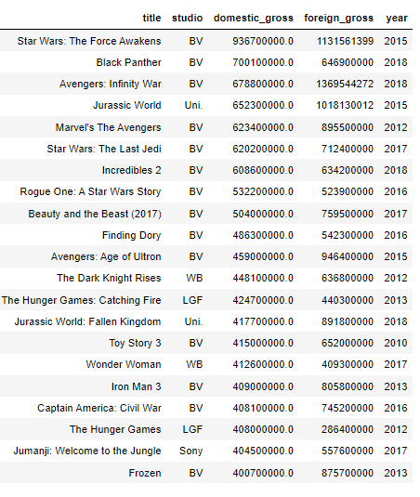
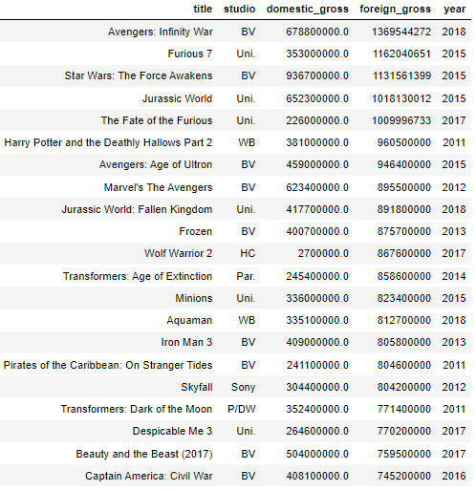
Sequels and Box Office Trend
When looking at the top domestic grossing and top foreign grossing movies, I was seeing a lot of 2’s, 3’s, and colons, all of which are indicative of sequels.
Furthermore, the highest domestic grossing movie (“Star Wars: The Force Awakens”) and the highest foreign grossing movie (“Avengers: Infinity War”) were both sequels of well established series.
Let’s take a look at the two series

Slide 15
Star Wars
The first Star Wars film “Episode IV: A New Hope” came out in 1977.
The film had a smaller budget of 11 million, and initially opened in only 42 theatres.
However it was an almost instant hit, and would reach over 700 million dollars in worldwide box office revenue.
It would go on to change everything from the popularity of Science Fiction as a genre, to special effects, to merchandising as we know it.
Two more movies were released in 1980 and 1983, then 16 years later, a new trilogy was introduced with “Star Wars Episode 1: The Phantom Menace”.
By the time the sixth Star Wars movie came out in 2005, the franchise had already brought in over 19 billion dollars.

Slide 16
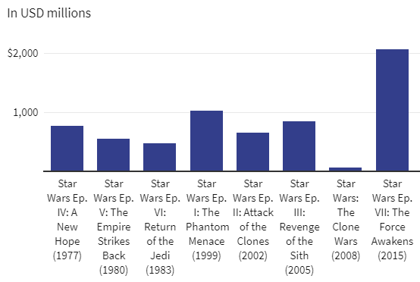
Star Wars
Then, ten years later “Star Wars Episode VII: The Force Awakens” came out, and took the box office by storm.
The film itself grossed 2 billion worldwide and broke several records including highest worldwide opening weekend, highest IMAX single day gross, and fastest film to gross 1 billion dollars.
In the figure presented, you can see the success in box office each time a new Star Wars Trilogy movie is introduced with The Force Awakens being the most successful.

Slide 17
The Marvel Franchise
The Marvel Franchise is a little complex full of reboots and several different phases which introduced various comic book heroes into the Marvel cinematic universe, so for simplicity we’ll start with Iron Man.
Iron Man came out in 2008, and at the time Marvel was a small independent company.
Iron Man did well, grossing over 585 million dollars.
So well in fact that in 2009, Disney bought Marvel, and the rest is history.

Slide 18
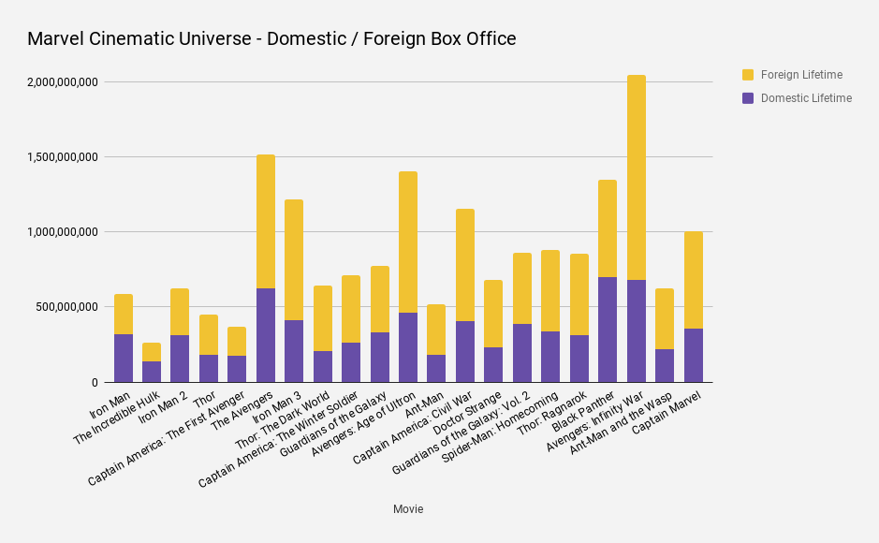
The Marvel Franchise
After that, Disney started releasing movies like clockwork.
Disney developed a pattern where movies like Captain America: The First Avenger, Thor, Guardians of the Galaxy, Ant Man, Doctor Strange etc, would come out and introduce new heroes, and then release one giant movie that would combine all the heroes into one.
These giant movies such as The Avengers, Avengers: Age of Ultron, Avengers: Infinity War , would be box office hits.
The figure shown on the right shows this trend, which supports the idea that movies that build on older movies tend to do well.

Slide 19
Recap
3 factors to focus on for a successful movie were suggested:
Genre of movie
Production budget of film
Building on nostalgia or sequels
Each of these factors have been examined carefully using data and data analysis procedures from various sources.
What follows next are my suggestions per each factor.

Slide 20
Genre Suggestions
Adventure has been consistently shown to be the top genre in the US, followed by action.
Therefore to build a solid foundation for an audience, it is suggested that your first movie should be in the adventure genre.
However to have a successful action movie, you also need a solid story/script and a good director as well.
Therefore getting big name action genre directors like Christopher Nolan or Joe Russo involved would be highly suggested.
Once successful movies have been established by your studio, then you can start branching out into other genres

Slide 21
Production Budget Suggestions
As mentioned before the average Production Budget is between 100 and 150 million dollars.
This is a good price point to keep it around, but if the budget needs to be stretched for things like improved special effects or hiring certain prestigious actors, then it should be done.
Special effects in particular can be important, especially if you’re making an adventure movie, with elements of action but don’t overdo it.
The budget should also be used for things like marketing, travel, and equipment.

Slide 22
Sequel and Nostalgia Suggestions
As shown earlier, movies that build on older movies in the series as well as sequels do well in the box office.
Some examples are Star Wars and the Marvel cinematic universe movies.
My suggestion is that you pick a movie series that does not have many entries in the series and build upon it from there or try your hand at rebooting a series.
There are several movies/movie series out there that haven’t seen a new release in years that would fill the audience with nostalgia.
Some examples that come to mind are several Stephen King movies, the Rush Hour series, the Sherlock Holmes series, just to name a few.

Slide 23
Afterthoughts
Microsoft also produces video games, including classic series with diehard fans like Halo and Gears of War, yet no movie for either series has been made.
A Halo live action movie could prove to be lucrative as it would play on many an adult’s nostalgia of their early days of playing Halo, and the Halo series has a strong and compelling story ready to be told on the big screen.
Covid greatly interrupted the film industry, and brought all new popularity to streaming services like Disney+, Netflix, Hulu, etc.
These streaming services often have the option to watch movies from home instead of the theater, which a recent study showed people actually prefer.
Therefore it may be a smart business move later on to either partner with a streaming service to produce movies, or create a new Microsoft movie streaming service.

Slide 24
References
https://www.zippia.com/advice/us-film-industry-statistics/
https://www.forbes.com/sites/rosaescandon/2020/03/12/the-film-industry-made-a-record-breaking-100-billion-last-year/?sh=6eac73f834cd
https://www.eksposure.com/movie-statistics/
https://www.statista.com/statistics/188658/movie-genres-in-north-america-by-box-office-revenue-since-1995/
https://www.boxofficemojo.com/chart/top_lifetime_gross/?area=XWW
https://www.nfi.edu/how-much-does-it-cost-to-make-a-movie/#:~:text=Average%20Cost%20of%20Making%20a,than%20%24200%20million%20to%20produce.
https://www.investopedia.com/financial-edge/0611/why-movies-cost-so-much-to-make.aspx
https://collider.com/best-low-budget-films-into-blockbusters/
https://www.investopedia.com/articles/investing/102215/why-star-wars-franchise-so-valuable.asp#:~:text=The%20Star%20Wars%20franchise%2C%20created,most%20successful%20in%20the%20world.&text=The%20success%20of%20the%20Star,clever%20targeting%20of%20many%20demographics.
https://www.britannica.com/topic/Star-Wars-film-series
https://www.hollywoodinsider.com/marvel-iron-man-blue-ocean-strategy/
https://www.resetera.com/threads/captain-marvel-the-road-to-1-billion-at-the-box-office.104787/
https://www.statista.com/statistics/947757/theaters-streaming-watching-movies/

Slide 25
QUESTIONS?

